Slide 1
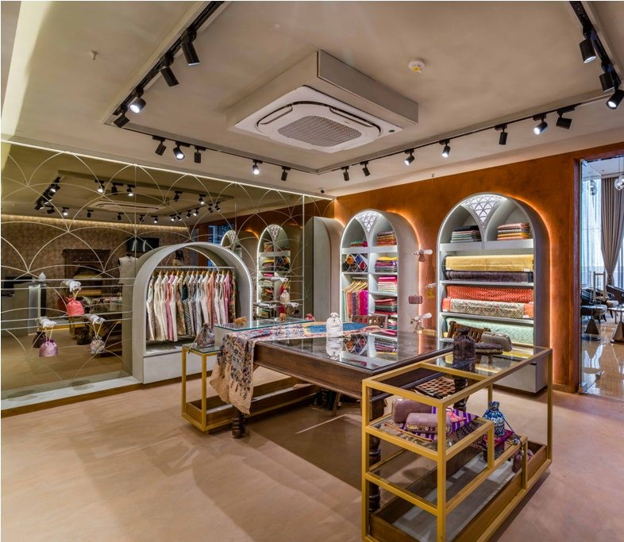

VELVET
VOGUE
STYLE FOR EVERY STORY

Slide 2
Prepared By:
Roll No. | Name | Enrollment No.
82 | AGRESHA SHAH | 22002170110155
94 | CHIRAG PATEL | 22002170110107
95 | HENIL SUTARIYA | 22002171410058
99 | YASVI VAGHASIYA | 22002170110199
104 | JIYA SHAH | 22002170110164

Slide 3
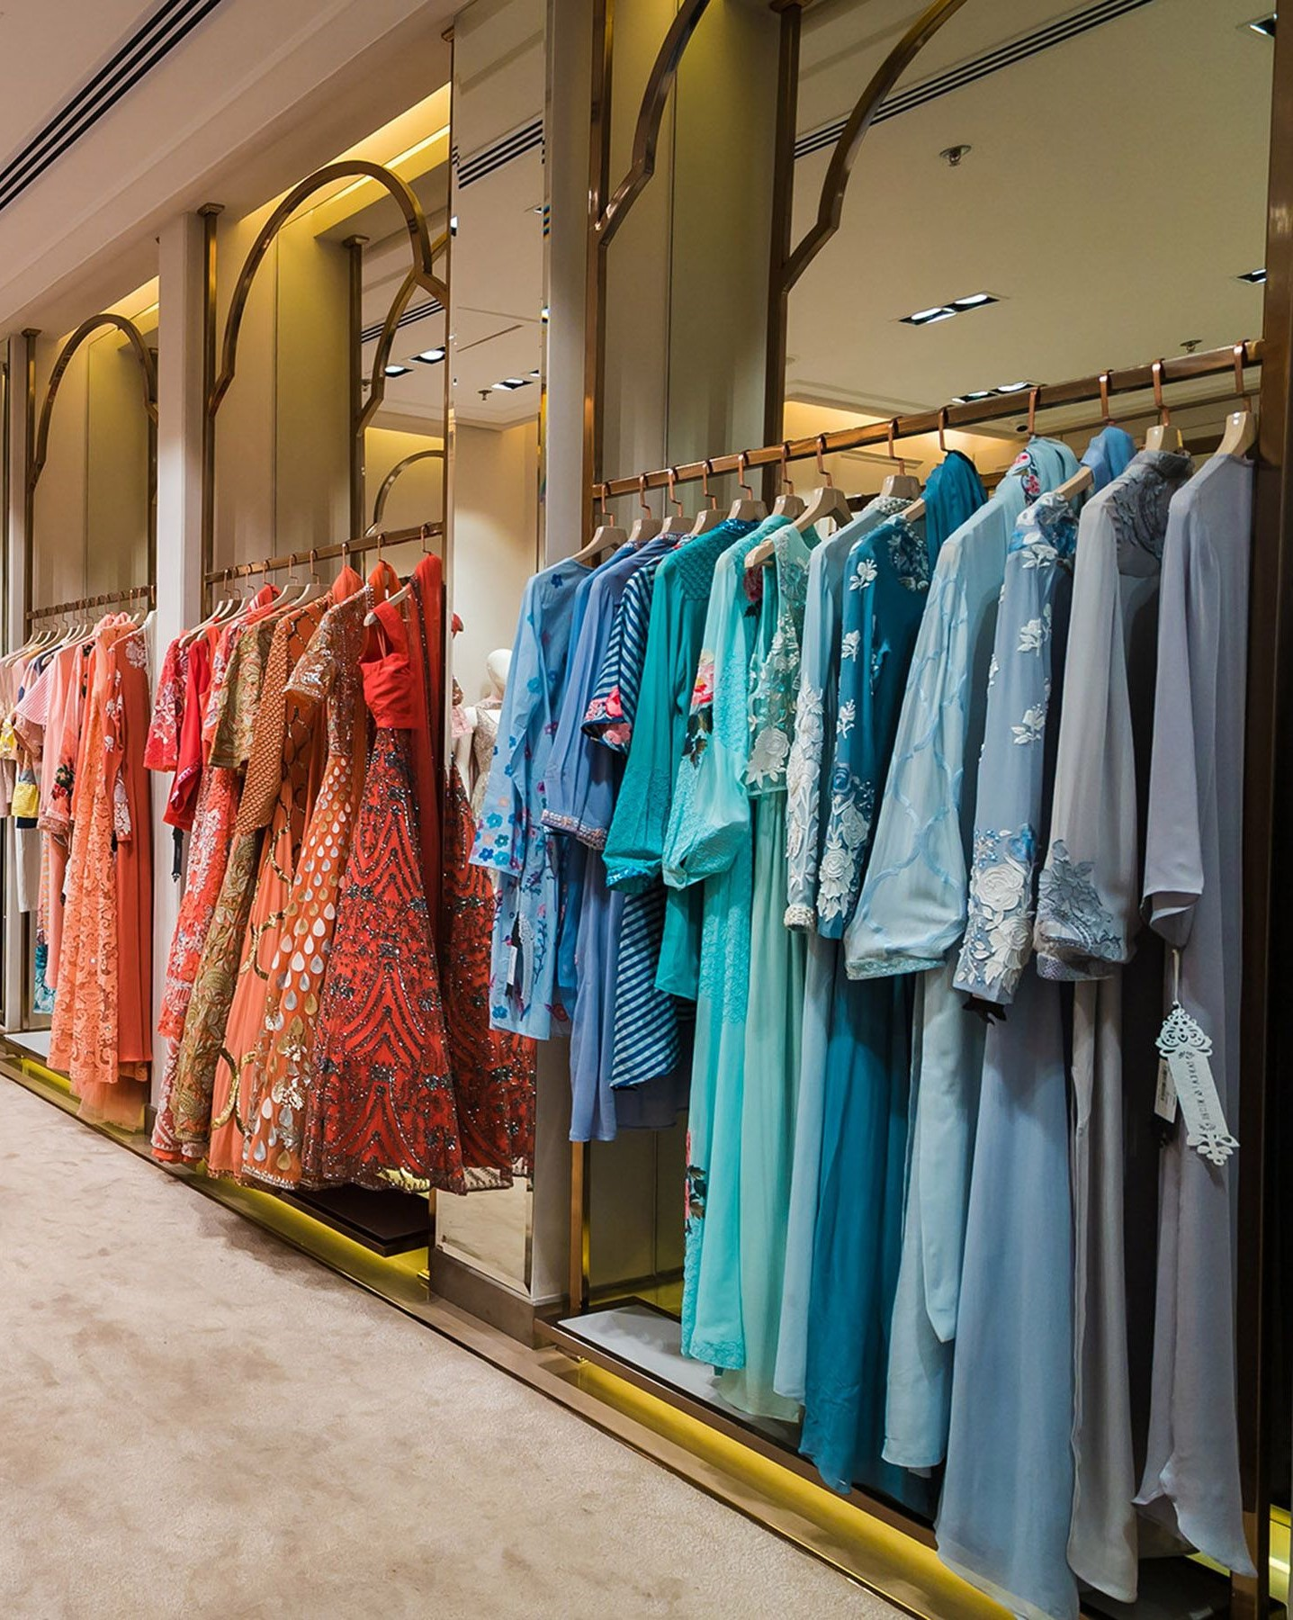
Introduction
This project uses front end developing to create an attractive online boutique website.
Our online boutique brings together a curated collection of the latest trends and timeless classics, all within a seamless browsing experience
This website ensures that there is a smooth flow of the user interface with it.
This website allows the user to see, shop, compare and buy clothes at the comfort of their home.

Slide 4
Project Outline
Seamless website experience crafted with Bootstrap, JavaScript and HTML.
This website uses all website functionalities like header, scroll spy , navbar, footer, forms etc.
The navbar gives easy access to different categories and option all over the website.
The footer provides information like address, phone no. of different branches.
The home pages displays all of these along with the signature outfits of our boutique
The form fill is for the future notifications and offers.
The header signifies the unique website logo

Slide 5
Functionalities
NAVBAR
HEADER
CAROUSEL
SCROLL SPY
DISPLAY
IMAGES
DIFFERENT PAGES
FORM
FOOTER

Slide 6

Merits
Easy shopping from anywhere around the world.
Can compare from various options without any human work.
Easily accessible to more people using social media.
Brand development.
Visually attractive designs.
Getting customer feedback easily.

Slide 7

Demerit
Not Time and Cost Efficient
Dependency on Framework Updates and maintenance.
Browser Compatibility Issues.
Performance Concerns and responsiveness issues.
Can lead to problem to user having slow internet connections
or old devices.

Slide 8
Future Scope
Using of more advance front-end like ecma-6.
Personalization and AI
Blockchain Technology
Social Commerce Integration
Integrating with database
Setting logics dynamically with the use of backend languages

Slide 9
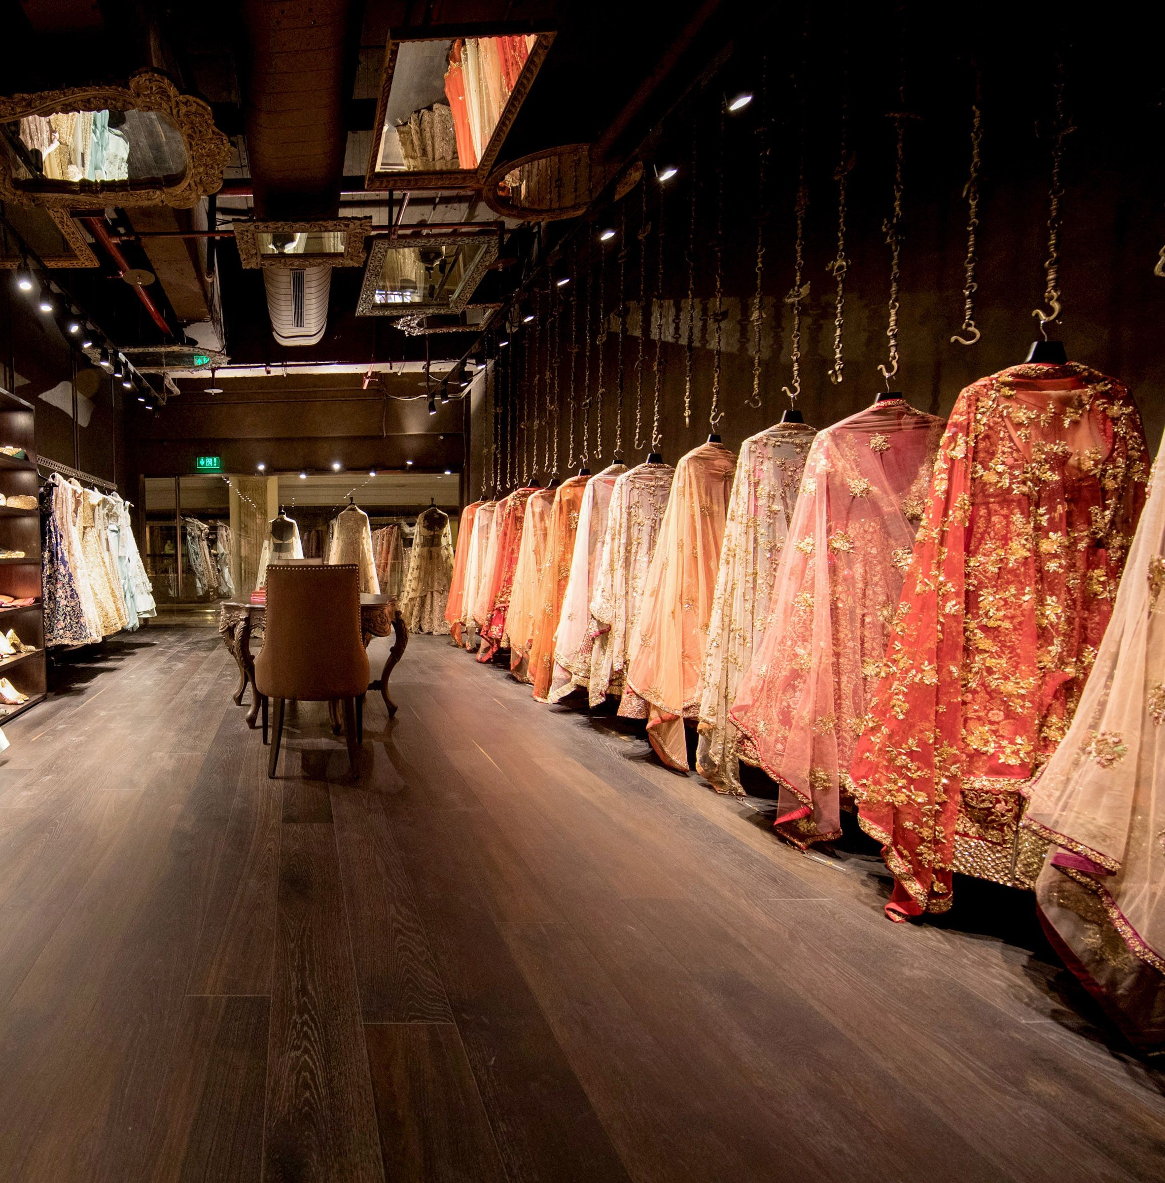
Thank You
STYLE FOR EVERY STORY STYLE FOR EVERY STORY
VELVET
VOGUE​
+91-99799 51420
velvet.vogue@yahoo.com
www.velvetvogue.com

